Slide 1
A weighted bilinear neural collaborative filtering approach for drug repositioning
Deepa Raj 20IM10006
Jasit Bhakat 20IM10014

Slide 2
Introduction
Drug repositioning is an efficient and promising strategy for traditional drug discovery and development. Many research efforts are focused on utilizing deep-learning approaches based on a heterogeneous network for modeling complex drug–disease associations. Similar to traditional latent factor models, which directly factorize drug–disease associations, they assume the neighbors are independent of each other in the network and thus tend to be ineffective to capture localized information. In this study, we propose a novel neighborhood and neighborhood interaction-based neural collaborative filtering approach (called DRWBNCF) to infer novel potential drugs for diseases.

Slide 3
Research Paper Used
Meng, Y., Lu, C., Jin, M., Xu, J., Zeng, X. and Yang, J., 2022. A weighted bilinear neural collaborative filtering approach for drug repositioning. Briefings in bioinformatics, 23(2), p.bbab581.
Link : https://academic.oup.com/bib/article/23/2/bbab581/6510159?login=true

Slide 4
Need for a new approach
Many studies have suggested that matrix factorization and completion methods become promising computational strategies for drug repositioning. These methods can be regarded as a linear multiplication of latent features. Although these methods have achieved strong performance, a deficiency is that they cannot effectively capture the complex structure of drug– disease association data and efficiently handle the high complexity matrix operations on large-scale data.
To tackle the problem, some pioneering studies developed deep-learning-based models for drug repositioning. However, existing deep-learning models may be ineffective to capture the interactions between neighbors and thus lower the drug repositioning quality. Thus, a novel drug repositioning approach based on weighted bilinear neural collaborative filtering is proposed.

Slide 5
Problem formulation
Assume that we have a set of drugs and diseases, denoted by R and D respectively. Let r ∈ R denote a drug and d ∈ D denote a disease, and Yr,d be the association label between r and d. If r has associated with d, Yr,d = 1, otherwise Yr,d = 0. We call a drug–disease pair an association pair when Yr,d = 1. The drug repositioning can be defined as a prediction problem .

Slide 6
DRWBNCF
Steps involved in the implementation of DRWBNCF :
Networks: Construct three networks for drug-disease associations, drug-drug, and disease-disease similarities.
Neighborhood Focus: Emphasize the influence of the most similar drugs and diseases to improve accuracy.
Integration: Employ weighted bilinear graph convolution to merge known associations and neighborhood interactions.
Prediction: Use a multi-layer perceptron with specialized loss functions to model complex drug-disease relationships.
Unified MLP Network: Combine known associations and neighborhood data in a unified neural network.
Performance: Outperforms other methods in drug repositioning on real-world datasets.

Slide 7
Dataset used
In this study, we utilize a real-world dataset previously employed in evaluating the effectiveness of DRWBNCF. The dataset is known as F-dataset, and it comprises 1933 confirmed associations between 593 drugs sourced from the DrugBank database and 313 diseases listed in the OMIM database.
Dataset :

Slide 9
Construction of three networks
Drug-Disease Association Network (G) :
A binary matrix A (n x m) with entries A_{ij} ∈ {0, 1}.
A_{ij} = 1 if drug ri associates with disease d_{j}; otherwise, A_{ij} = 0.
Drug-Drug Similarity Network (G^{r}) :
Matrix A^{r} (n x n) derived from drug similarities matrix S^{r} (n x n).
Utilizes k-nearest neighbors (N_{k}(r_{i})) to reduce noise.
A^{r}_{ij} = S^{r}(i, j) if rj ∈ N_{k}(r_{i}); 0 otherwise.
Disease-Disease Similarity Network (G^{d}) :
Matrix A^{d} (m x m) derived from disease similarities matrix S^{d} (m x m).
Utilizes k-nearest neighbors (N_{k}(d_{i})) for improved accuracy.
A^{d}_{ij} = S^{d}(i, j) if d_{j} ∈ N_{k}(d_{i}); 0 otherwise.

Slide 10
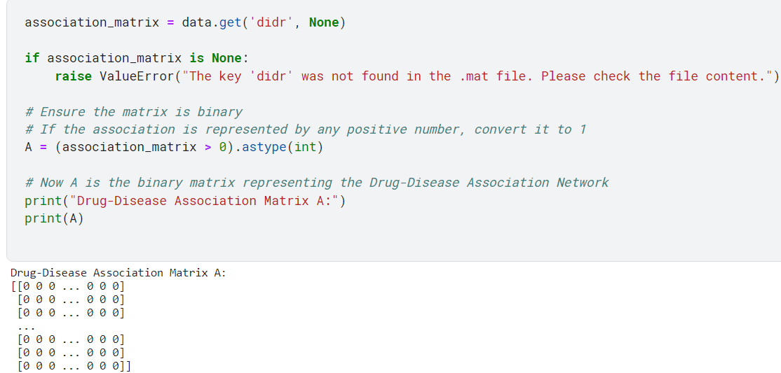
Implementation of Drug-Disease Association Network (G)
Load the .mat file that contains the dataset.
Extract the drug-disease association matrix, assuming it's named didr.
Convert any positive associations to 1, ensuring the matrix is binary.

Slide 11
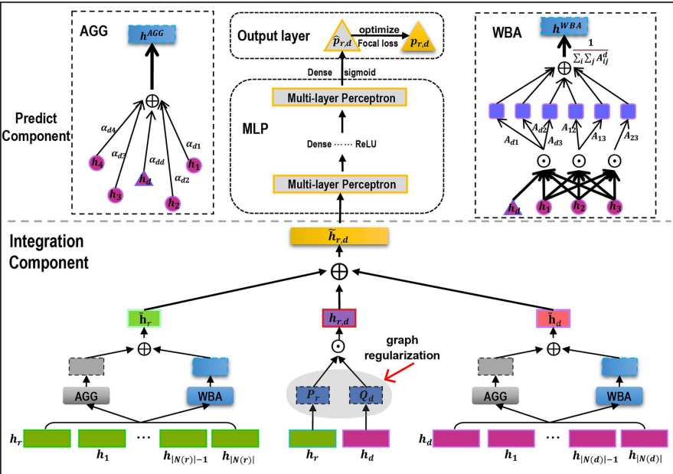
Workflow of DRWBNCF
The overall architecture of DRWBNCF.
DRWBNCF involves two components:
(i) an integration component, which describes how to encode the known drug–disease association together with neighborhood and neighborhood interactions of the drug and disease;
(ii) a prediction component, which utilizes the multi-layer perceptron optimized by the α-balanced focal loss function and graph regularization to model the complex drug–disease associations

Slide 12
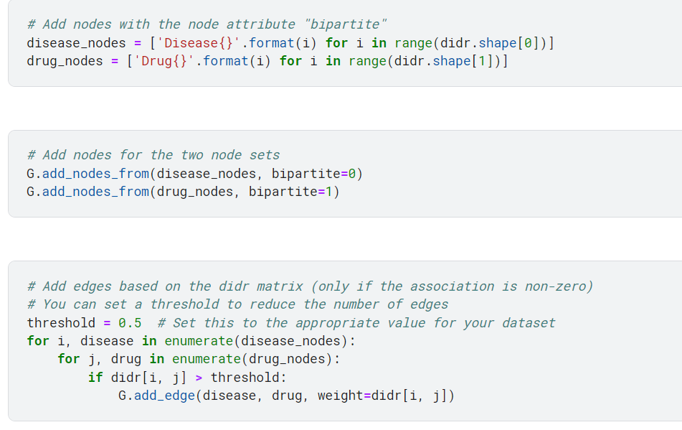
Bipartite Graph to see the associations

Slide 13
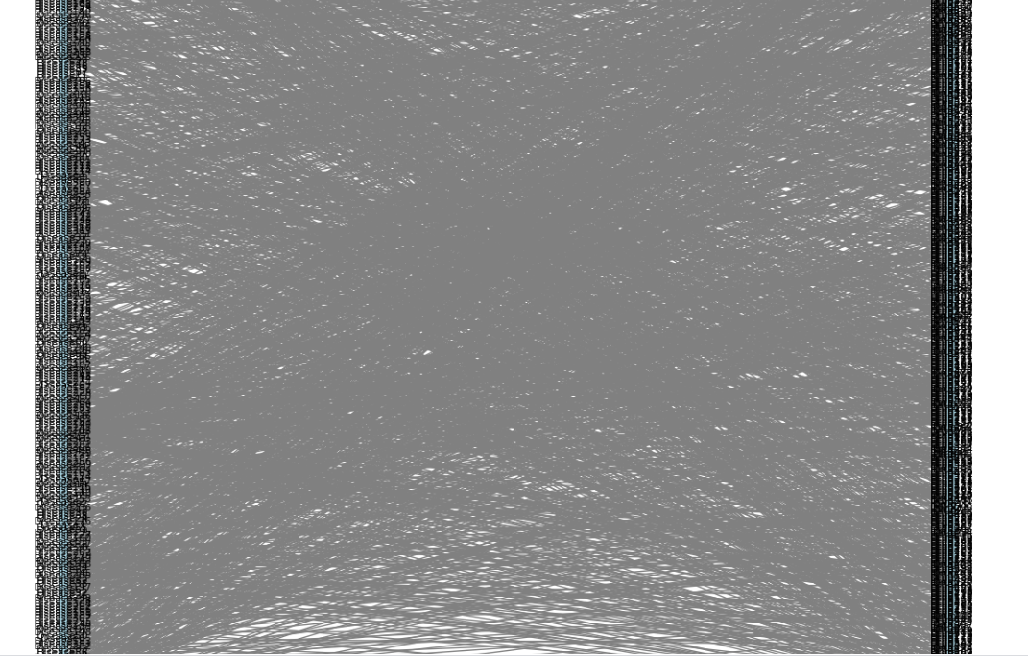
Bipartite Graph

Slide 14
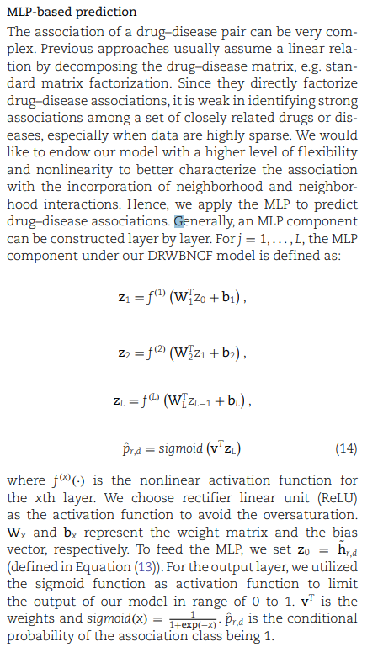
Part of the Paper Implemented

Slide 15
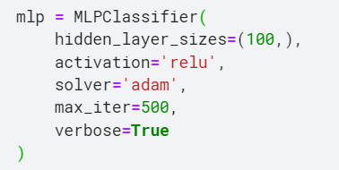
Architecture of the MLP model
Here, an MLPClassifier object is instantiated with one hidden layer of 100 neurons, using the ReLU activation function and the Adam optimizer, set to run for a maximum of 500 iterations.

Slide 16
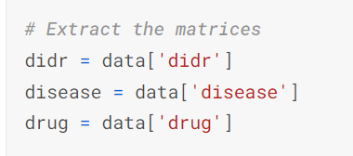
Predicting associations between drugs and diseases
Data Loading and Processing:
It begins by loading a dataset from a .mat file, which is a format typically used in MATLAB. This file contains matrices that represent different types of data related to drugs and diseases.
Feature Construction:
The code constructs features by combining information from the disease and drug matrices. This process creates a feature vector for each potential drug-disease pair by concatenating the disease's features with the drug's features. The assumption is that the combination of these features can be used to predict whether a particular drug is associated with a particular disease.

Slide 17
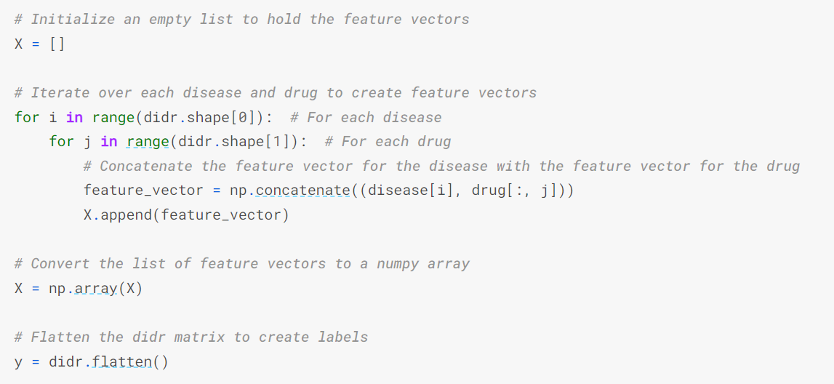
These lines iterate over each disease and drug, creating a feature vector by concatenating the features of the disease with the features of the drug, and then append this feature vector to the list X

Slide 18
Labels
0: This label typically signifies a negative class, which means that the particular instance (in your case, a drug-disease pair) does not have the condition being predicted. For instance, if you're predicting whether a certain drug is effective for a certain disease, a "0" would indicate that there is no known or predicted effective association between the drug and the disease.
1: Conversely, this label represents a positive class, indicating that the instance does have the condition or attribute being predicted. Following the same example, a "1" would mean that the drug is predicted to be effective for the disease, or there is a known association.

Slide 19
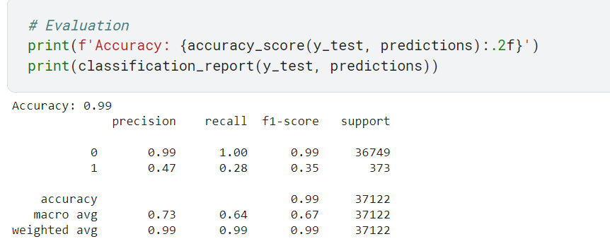
Since we see there is data imbalance hence we also added SMOTE (a up sampling technique) and also tried down sampling and we noticed it promises better result.

Slide 20
Thank You

